Slide 1
A computational model for glycogenolysis in skeletal muscle
By Melissa J. Lambeth and Martin J. Kushmerick
Grayson Gerlich and Alexa Schwartz

Slide 2
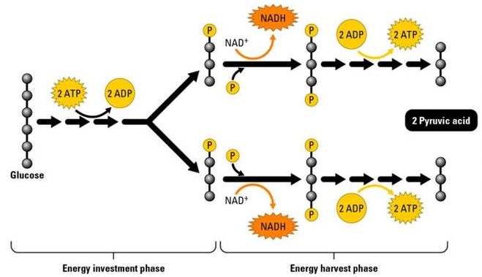
Glycolysis and Glycogenolysis
ATP is generated through aerobic respiration starting with glycolysis
In mammalian muscle cells, ATP is used for muscular contractions.
Glycogenolysis = breakdown of glycogen into glucose

Slide 3
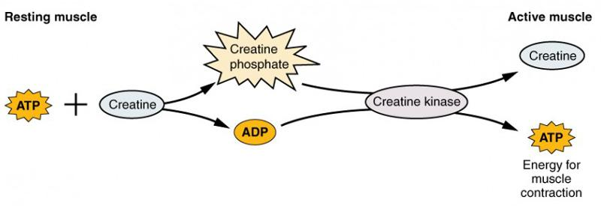
Gaps in Modeling
Due to complications previous work done to model glycolysis in muscle from 1968.
Key issues:
1) Dynamic flux of ATP
2) Variability caused by muscle properties and intensity of contractions
3) Uncertainty in enzyme kinetics
4) Disagreement within the research community regarding flux control mechanisms.

Slide 4
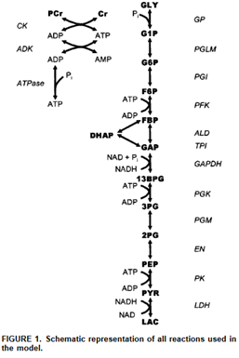
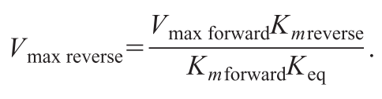
Review of Model
The model uses Michaelis-Menten kinetics - absence of external regulators
Creatine kinase (CK), adenylate kinase (ADK), and ATPase are introduced to describe the conditions in skeletal muscle
Haldane relation can describe reverse reactions

Slide 5
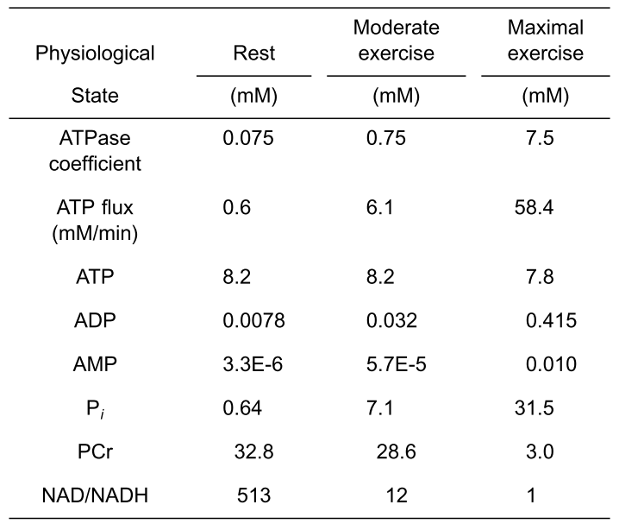
Modelling Different Exercise States
The simulation was run under three conditions
Resting (low ATP flux)
Moderate exercise (moderate ATP flux)
Maximal exercise (high ATP flux)
Reflects broad range of physiological ATP fluxes

Slide 6
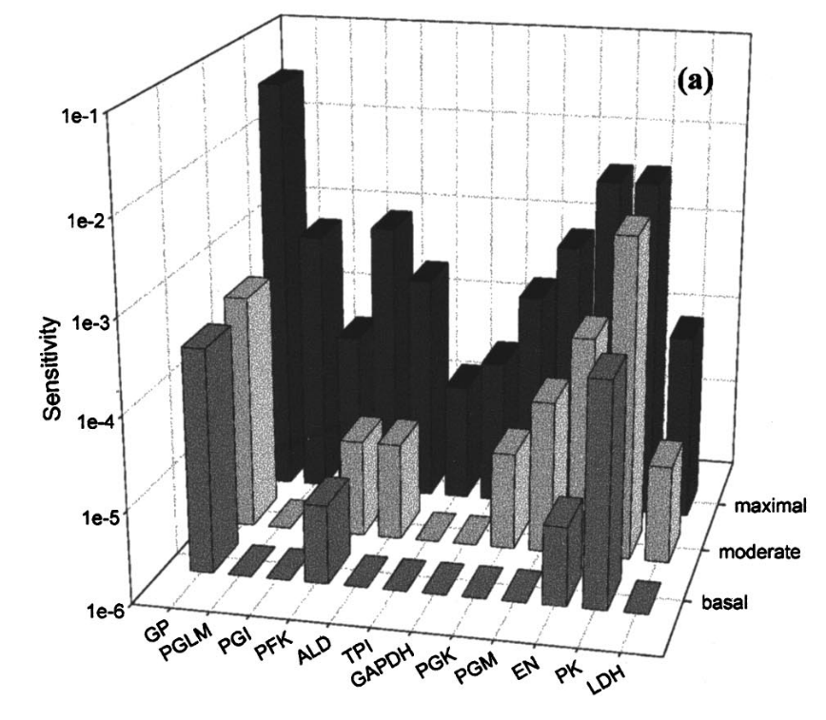
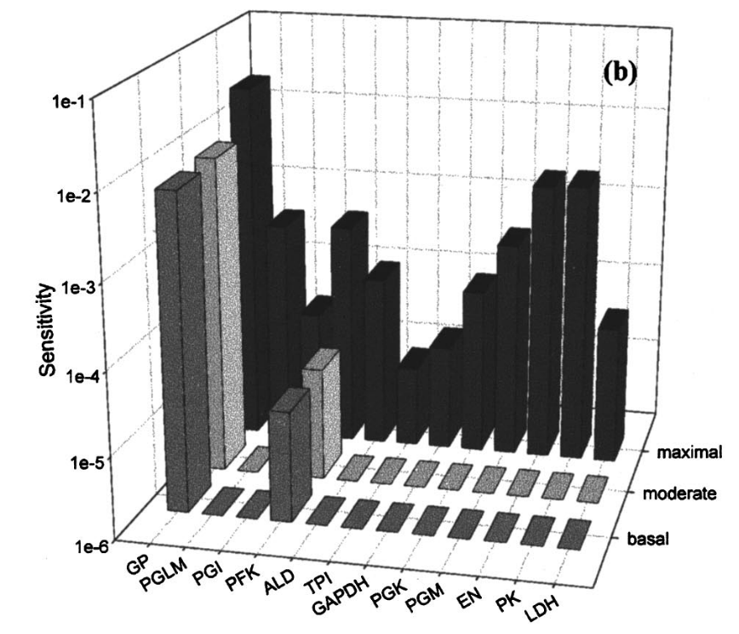
Sensitivity Analysis
1% perturbations in each V_{max} and initial concentration except for ATPase which exerts 95% control
Performed for rest, moderate exercise, and maximal exercise conditions
Resting GP isozyme ratio data that isn’t relevant to our goals, so we did not repeat
Notes:
Is with 40:60 ratio of glycogen phosphorylase a to phosphorylase b (normally observed isozyme ratio)
Is with 1:99 ratio of phosphorylase a to b
Generally, only enzymes far from equilibrium are important until maximal exercise, when all become important for control. Additionally, b shows that at maximal exercise, performance is recovered. This helps illustrate the physiologically observed mechanism by which, at maximal exercise, the system shifts to being dependent on AMP and other factors rather than phosphate.

Slide 7
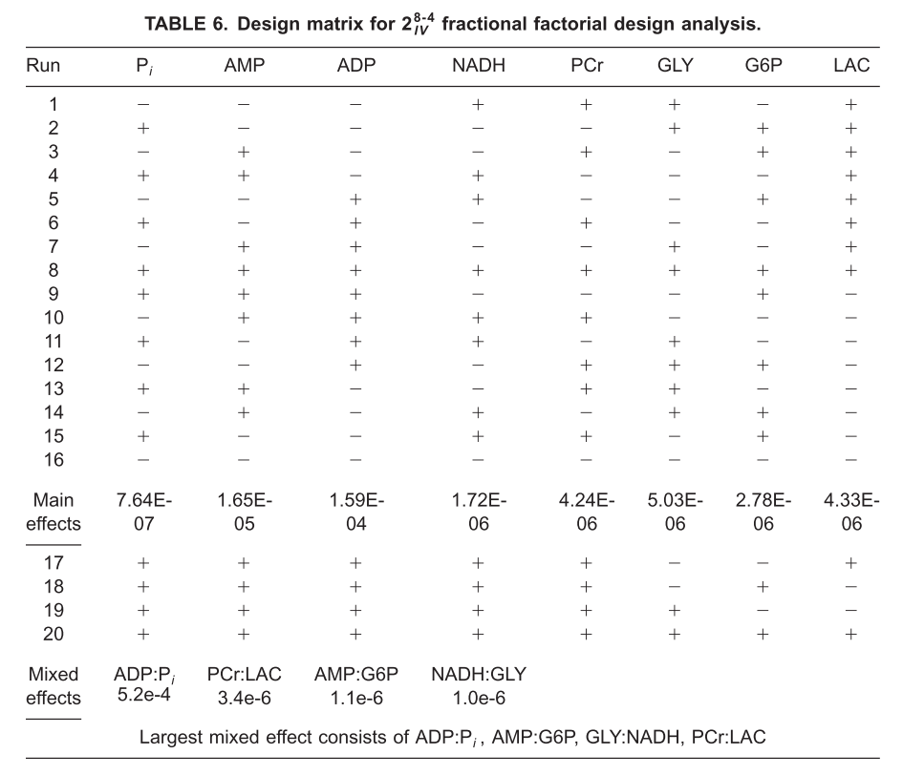
Fractional Factorial Design Analysis
Seeks to determine the effect of larger perturbations
Particularly useful in muscles, which experience fluxes far outside the 1% perturbation range
Notes:
Simulates the system with species at their maximum and minimum physiological concentrations, backsolves to determine which species has the highest effect on final product. Key result is that ADP:Pi has the highest effect, which we expect as P is crucial, but it suggests that ADP is more important than the sensitivity analysis alone shows.

Slide 8
Our Research Goals
Main Goals
The authors identify that using kinetic values from in vitro experiments is not ideal, and modeling should be done with in vivo values when experimentally available. Working to recreate the results of this paper, then replace those values with in vivo experimental data is a possible future analysis.
The fractional factorial analysis should be detailed better to allow multifactor effects to be considered. As it stands, the analysis is likely missing the value of AMP and other factors at maximal exercise levels.
Possible Expansions
The authors simplify an equation for bi-bi reactions due to a lack of information on random binding patterns at the time of publication. It is likely that this simplification has been sufficiently investigated in the past two decades.
Creating even a simplified model of biological lactate flux (with in vitro data) would significantly improve the diagnostic quality of the model.

Slide 9
A Quick Note on Bi-Bi reactions
Since Lambeth and Kushmerick’s work, a couple of these equations have been updated:
Pyruvate Kinase: Rapid-equilibrium random bi-bi reaction model is more accurate, but there is still a lack of binding constants in the gluconeogenesis direction to accurately characterize this, model unchanged
Phosphoglycerate Kinase: Rapid-equilibrium ordered bi-bi reaction is accurate, model unchanged
Notes:
We can take this slide out if you want, it does literally nothing to our model, but I did at least go look.

Slide 10
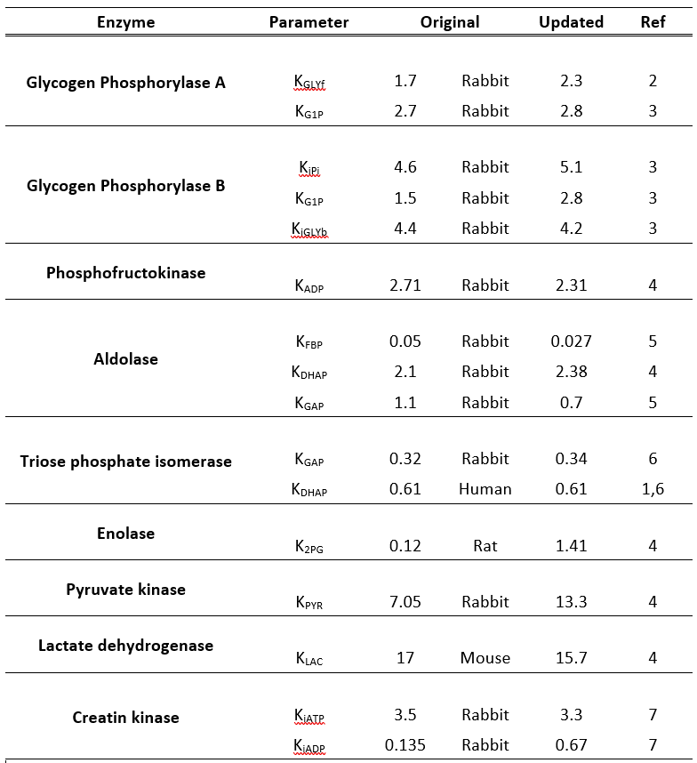
Parameters
Parameters used in original paper came from in vitro muscle cells from human, chicken, rat, rabbit, and pig.
Updated values close to original values within experimental error and sample variability

Slide 11
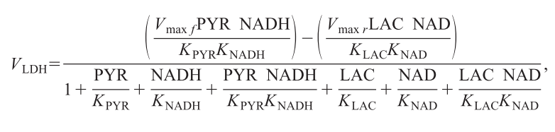
Let’s talk about modelling…
22 species
96 parameters
16 reactions
16 ODEs
22 algebraic equations
Most of them look something like this…

Slide 12
Let’s talk about modelling…
22 species
96 parameters
16 reactions
16 ODEs
22 algebraic equations
Most of them look something like this…
Okay, no problem, we got this…

Slide 13
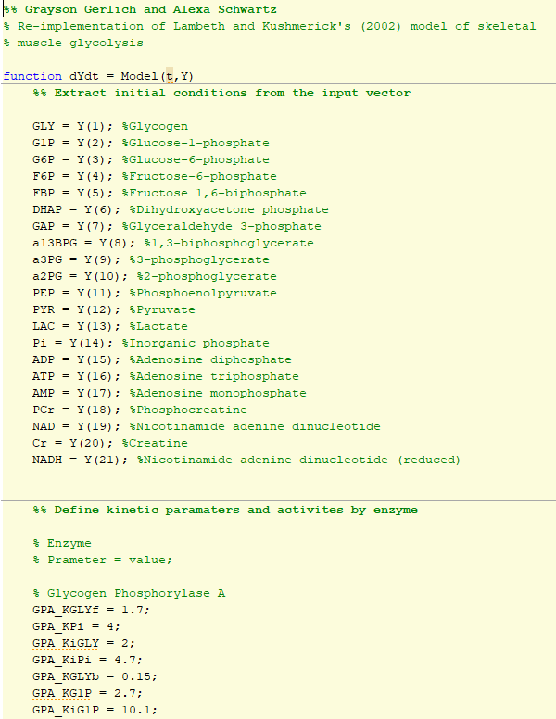
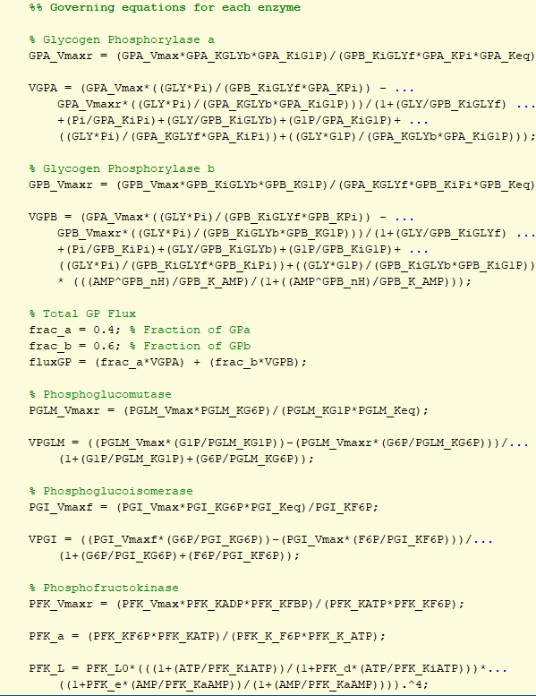
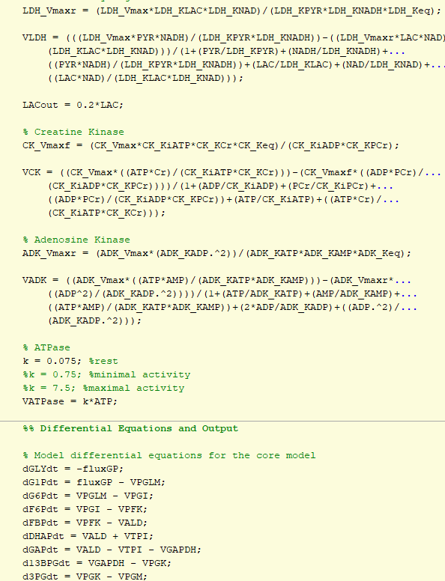
360 lines of code later…

Slide 14
360 lines of code later…

Slide 15
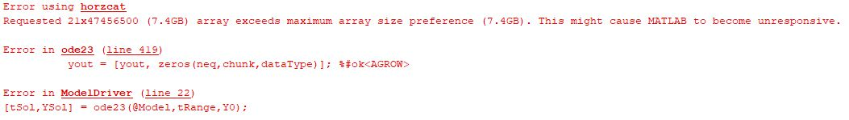
360 lines of code later…

Slide 16
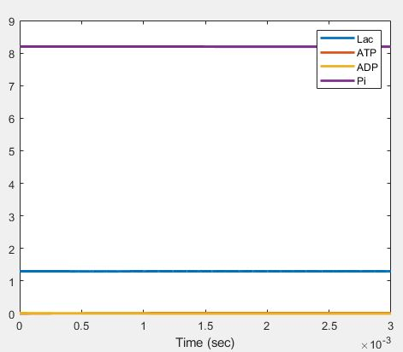
360 lines of code later…
5 minutes of simulation time…
3 milliseconds of simulation

Slide 17

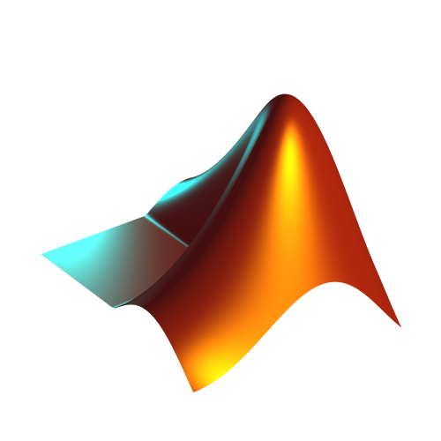
360 lines of code later…
5 minutes of simulation time…
3 milliseconds of simulation

Slide 18
So, jokes aside, why isn’t Matlab working?
This model is a perfect storm for stumping Matlab’s ODE solvers for two main reasons:
Incredibly stiff early dynamics (4 orders of magnitude timescale differences)
3 orders of magnitude difference between physiological Vmax values
Haldane relation can generate obscenely small Vmax_{reverse} values
8 orders of magnitude difference in initial conditions
The relative tolerance (RelTol) of most matlab ODE solvers is only 1e-4!

Slide 19
Possible solutions
Use a stiffer solver
Gets too caught up in early dynamics, and there’s no way to do fixed-interval integration in Matlab to avoid this
Use a supercomputer
Because of variable interdependencies, Matlab ODE solvers cannot effectively run in parallel
Simplify the system
The strength of Lambeth and Kushmerick’s model is its comprehensiveness, we’d be compromising on our goals with timescale or steady state approximations
Split the model and solve separately
Not an option due to aforementioned interdependencies
Use the right software for this task
Oh hey, you might be onto something…

Slide 20

Enter the hero…
Robust fixed-interval LSODA integration
Hybrid stiff/non-stiff system which switches stiffness automatically
Can also use the RADAU method used by Lambeth and Kushmerick for nearly identical results, just orders of magnitude slower
Built-in tools for sensitivity analysis
Actually, you know, built for systems biology…
You’ll get ‘em next time Matlab…
Notes:
RADAU is runge kutta method of variable order

Slide 21
Lets see some actual model dynamics, totally unexplored by Lambeth and Kushmerick!
Stats for nerds:
Simulated each with 2400 intervals on different timescales
LSODA: <10 seconds (i7-6600U @2.6 GHz, 2 cores)
RADAU (used by Lambeth and Kushmerick): at least 20 minutes (i7-6600U @2.6 GHz, 2 cores)
ode23 in Matlab, barely running the short timescale: 35 hours (Ryzen 7 5800 @3.4 GHz, 6 cores, used 30.8 gb of my 32 gb of RAM)
Don’t get me started on ode15s

Slide 22
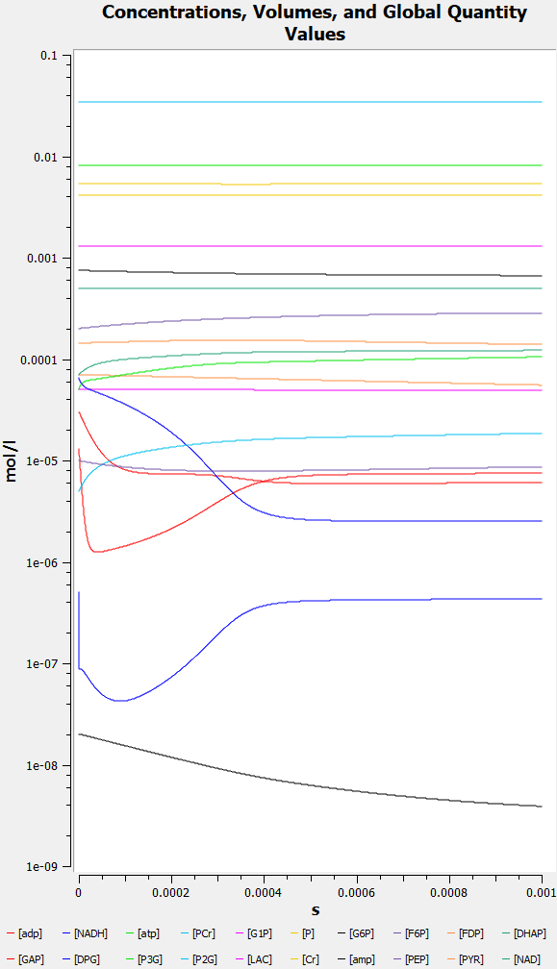
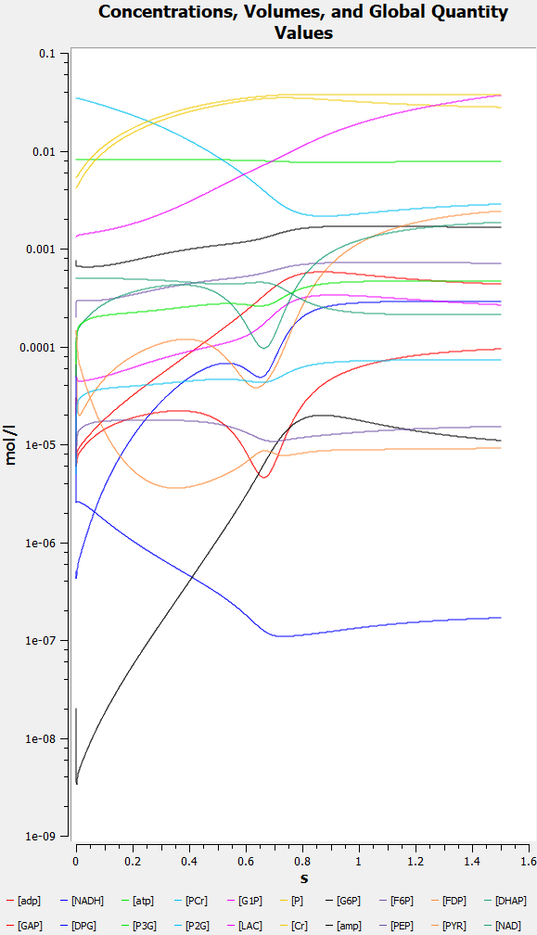
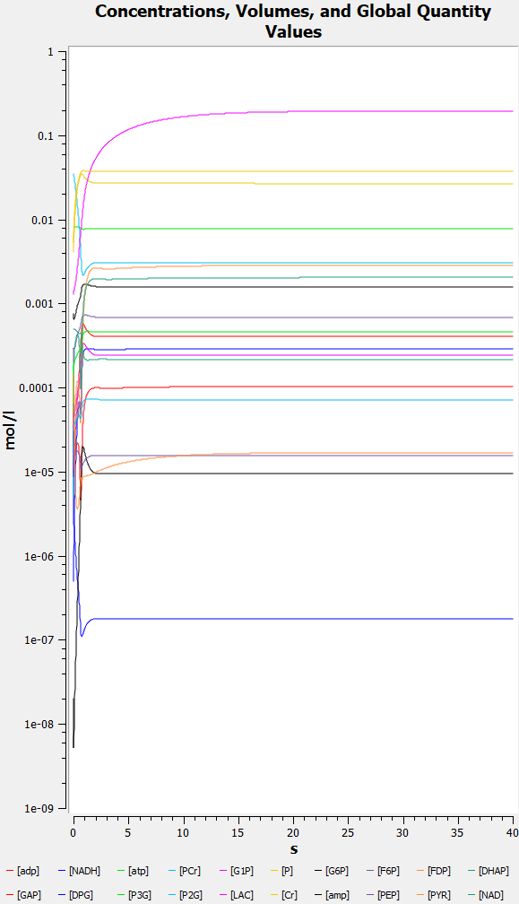
Notes:
Short timescale on the left, middle in the middle, long on the right. These are all run using the maximal exercise ATP flux for purposes of making the nicest graphs. These are really just here to demonstrate the incredible stiffness of this model. Enzymes close to steady state equilibrate VERY fast, those farther away (usually exhibiting more control)

Slide 23
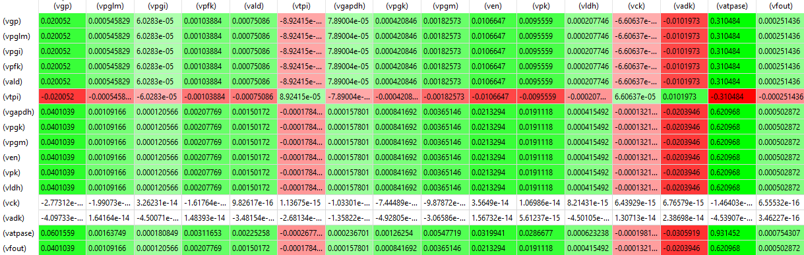
Thanks COPASI!
Notes:
Quick slide just demonstrating how cool COPASI is

Slide 24
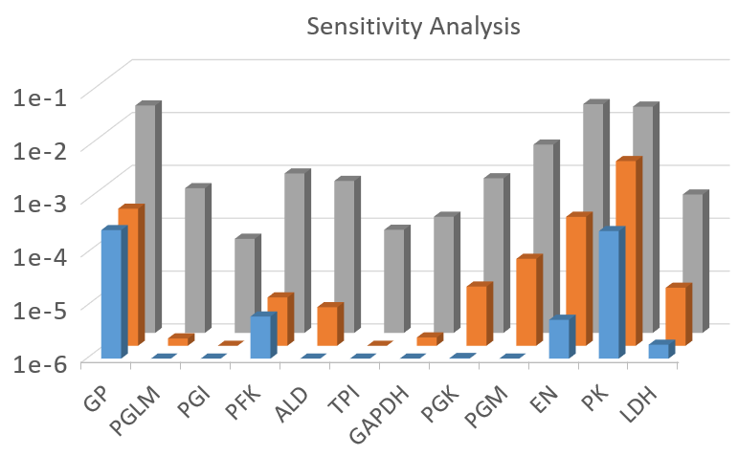
Sensitivity Analysis Comparison
Notes:
Our improved model captures some nuance lost by the overall model, and it is interesting to see the changes, but the major trends remain. Updated kinetic parameters for ALD really show here. This is actually crucial, as it shows that relatively small updates in literature values can have order-of-magnitude influence on small parameters. Sensitivities calculated through COPASI’s metabolic control analysis feature, plotted in excel. When we saw this, we figured we probably wouldn’t learn much from varying the isozyme ratio.

Slide 25
Sensitivity Analysis Comparison
Notes:
Our improved model captures some nuance lost by the overall model, and it is interesting to see the changes, but the major trends remain. Updated kinetic parameters for ALD really show here. This is actually crucial, as it shows that relatively small updates in literature values can have order-of-magnitude influence on small parameters. Sensitivities calculated through COPASI’s metabolic control analysis feature, plotted in excel. When we saw this, we figured we probably wouldn’t learn much from varying the isozyme ratio.

Slide 26
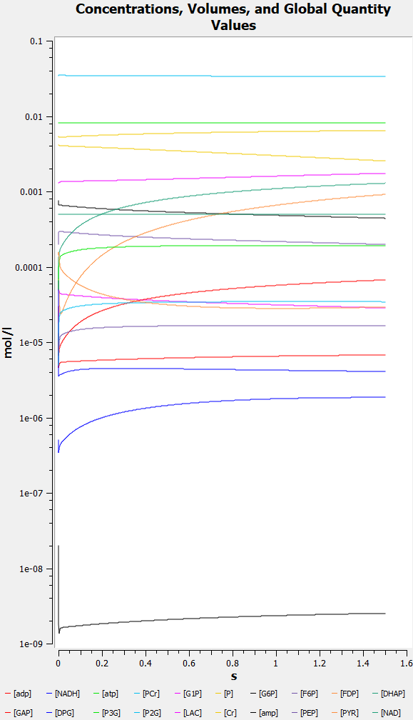
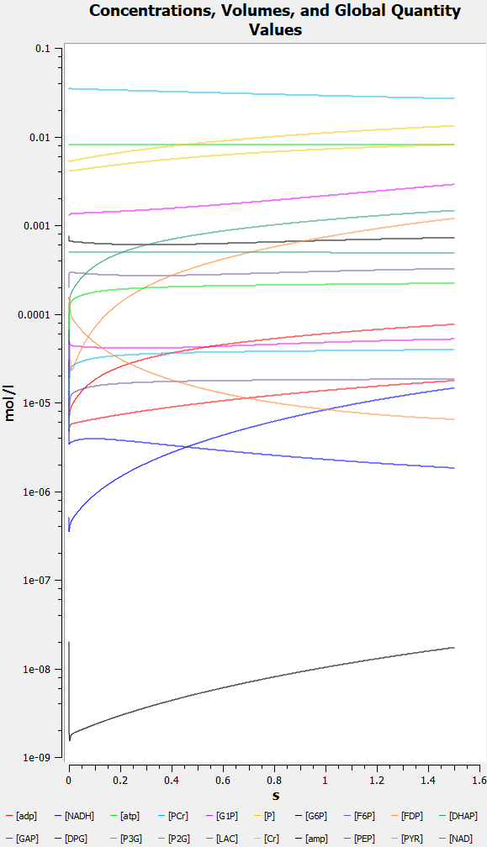
GAP
13BPG
GAPDH
Notes:
This is actually a visual representation of the flux control being distributed. GAPDH’s substrates, GAP and 13BPG, undergo a drastic change in steady state concentration, and take on a very intersting shape

Slide 27
Fractional Factorial Design Analysis
8 factors, so a normal 2-level factorial design would take 2⁸ (256) runs to assay each minimum and maximum concentration effect. If COPASI is so fast, why not do this?
Let’s talk FFD resolution for a moment
Resolution defines the ability of the analysis to tease out confounding effects
Resolutions below III and above V are generally considered useless
So we want resolutions IV or V
How to get there?
With 8 factors, we can run a 2⁸⁻⁴, resolution IV, FFD (min 16 runs)
With 10 factors, we could run a 2¹⁰⁻⁴, resolution V, FFD (min 64 runs)
Notes:
We don’t do this because it is a class project and I don’t have time to run 256 runs manually in COPASI and do all that shit in minitab. Our problem here, is that from our sensitivity analysis of our actual substrates, we don’t have 10 useful ones! Nor do we have time to run 64 fuckin runs.

Slide 28
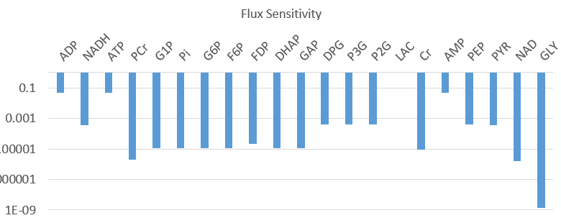
Fractional Factorial Design Analysis
Notes:
This is a rough and dirty graph, but in essence, we only have a handful of substrates that actually have a unique effect due to the stoichiometry of the reaction. Therefore, we don’t have 10 independent factors to assess.

Slide 29
Fractional Factorial Design Analysis - 2⁸⁻⁴ res. IV
All runs done manually in COPASI using published min/max concentrations
Data compiled and analyzed using Minitab with automatic principle fraction generation
ADP | Pi | PCr | LAC | AMP | G6P | NADH | GLY
1.61e-4 | 1.11e-6 | 3.94e-6 | 4.02e-6 | 1.86e-5 | 3.50e-6 | 1.55e-6 | 4.76e-6
ADP:Pi |  | PCr:LAC |  | AMP:G6P |  | NADH:GLY
6.9e-4 |  | 3.8e-6 |  | 1.2e-6 |  | 9.2e-7
Notes:
We don’t do this because it is a class project and I don’t have time to run 256 runs manually in COPASI and do all that shit in minitab. Our problem here, is that from our sensitivity analysis of our actual substrates, we don’t have 10 useful ones! Nor do we have time to run 64 fuckin runs. Green values indicate ones which increased from Lambeth, red indicates decreases (all of them changed, those are the interesting ones). What is really interesting here is that this shows the role of Pi (and the secondary effect of ADP and Pi) is actually more important than initially demonstrated. This further reinforces the role of ADP specifically in helping the pathway switch control at high metabolic rates.

Slide 30
Limitations
There is still a large gap in the literature for in vivo, human enzyme parameters
Full reversibility adds clear advantages, but the true value of the increased computational complexity is unknown
Our method doesn’t account for variability in parameters due to physiological differences
Wide difference in behavior from low exercise -> max exercise suggests the need for intermediary steps

Slide 31
Ideas for Future Work
Focus on specific pathologies by varying parameters, or by attempting to work backward from pathological steady states
Assume variation in observed parameters and automate a series of simulations to explore these spaces to look for highly variable outcomes
Create a simple model of biological lactate efflux to better assay total system flux

Slide 32
Conclusions
Our work updated the Lambeth and Kushmerick model to reflect modern experimental results and practices, demonstrating the importance of these updates through order-of-magnitude differences in sensitivity
We further confirmed the importance of ADP as a driver of control-switching at high metabolic rates
Using modern computational methods, this model is two orders of magnitude more efficient
Matlab is not my friend

Slide 33
Thank You
All figures and tables that aren’t ours are from the original source:
Lambeth, M.J., Kushmerick, M.J. A Computational Model for Glycogenolysis in Skeletal Muscle. Annals of Biomedical Engineering 30, 808–827 (2002).
It would be our pleasure to take any questions!

Slide 34
References
1. Lambeth, Melissa. Kushmerick, Martin. “A Computational Model for Glycogenolysis in Skeletal Muscle”. Annals of Biomedical Engineering. 30. 808-827. (2002)
2. Rush, James. Spriet, Lawrence. “Skeletal muscle glycogen phosphorylase a kinetics: effects of adenine nucleotides and caffeine”. J Appl Physiol. 91. 2071-2078. (2001)
3. Nikos G Oikonomakos, Vicky T Skamnaki, Erzsébet Ösz, László Szilágyi, László Somsák, Tibor Docsa, Béla Tóth, Pál Gergely. “Kinetic and Crystallographic Studies of Glucopyranosylidene Spirothiohydantoin Binding to Glycogen Phosphorylase b”. Bioorganic & Medicinal Chemistry.10. 261-268. (2002)
4. Wiśniewski JR, Gizak A, Rakus D. “Integrating Proteomics and Enzyme Kinetics Reveals Tissue-Specific Types of the Glycolytic and Gluconeogenic Pathways”. J Proteome Res.14. 3263-3273. (2015)
5. Eagles, Peter. Iqbal, Muzaffar. “A Comparative Study of Adolase from Human Muscle and Liver” Biochem J. 133. 429-439. (1973).
6. Dabrowska A, Kamrowska I, Baranowski T. Purification, crystallization and properties of triosephosphate isomerase from human skeletal muscle. Acta Biochim Pol. 25. 247-256. (1978)
7. Lee, C. Nicholson, G. O’Sullivan, W. “Some Properties of Human Skeletal Muscle Creatine Kinase” Aust J Biol Sci. 30. 507-517. (1977).

